Slide 1

HOTEL RESERVATION ANALYSIS
Using SQL
- DHIVYA PRABHA

Slide 2
GIVEN PROBLEM STATEMENTS
1. What is the total number of reservations in the dataset?
2. Which meal plan is the most popular among guests?
3. What is the average price per room for reservations involving children?
4. How many reservations were made for the year 20XX (replace XX with the desired year)?
5. What is the most commonly booked room type?
6. How many reservations fall on a weekend (no_of_weekend_nights > 0)?
7. What is the highest and lowest lead time for reservations?
8. What is the most common market segment type for reservations?
9. How many reservations have a booking status of "Confirmed"?
10. What is the total number of adults and children across all reservations?
11. What is the average number of weekend nights for reservations involving children?
12. How many reservations were made in each month of the year?
13. What is the average number of nights (both weekend and weekday) spent by guests for each room
type?
14. For reservations involving children, what is the most common room type, and what is the average
price for that room type?
15. Find the market segment type that generates the highest average price per room.

Slide 3
Dataset Details:
The dataset includes the following columns:
Booking_ID: A unique identifier for each hotel reservation.
no_of_adults: The number of adults in the reservation.
no_of_children: The number of children in the reservation.
no_of_weekend_nights: The number of nights in the reservation that fall on weekends.
no_of_week_nights: The number of nights in the reservation that fall on weekdays.
type_of_meal_plan: The meal plan chosen by the guests.
room_type_reserved: The type of room reserved by the guests.
lead_time: The number of days between booking and arrival.
arrival_date: The date of arrival.
market_segment_type: The market segment to which the reservation belongs.
avg_price_per_room: The average price per room in the reservation.
booking_status: The status of the booking.

Slide 4

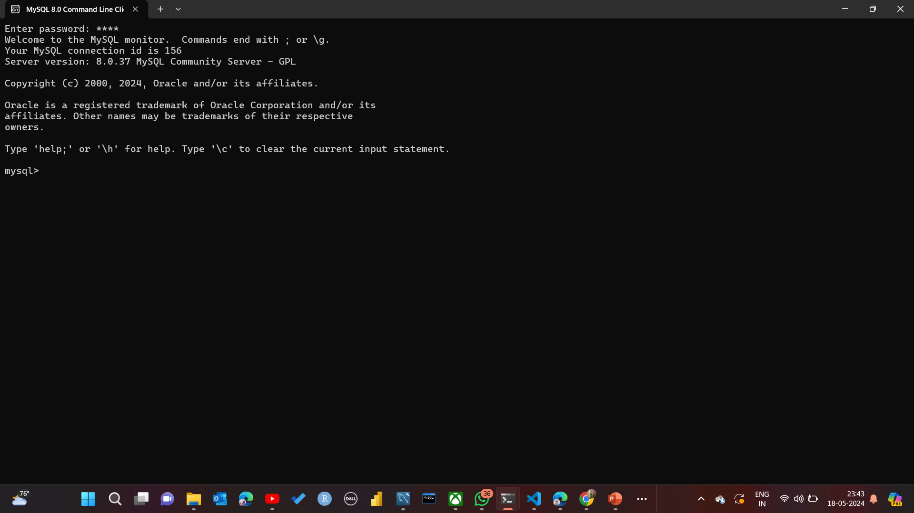
TOOLS USED
MySQL 8.0 Command Line Client

Slide 5
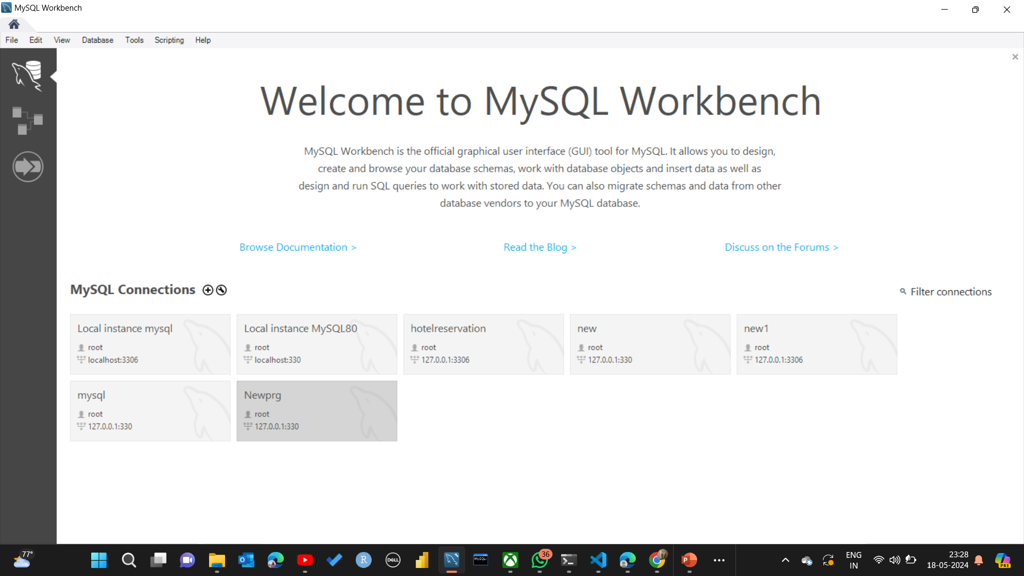
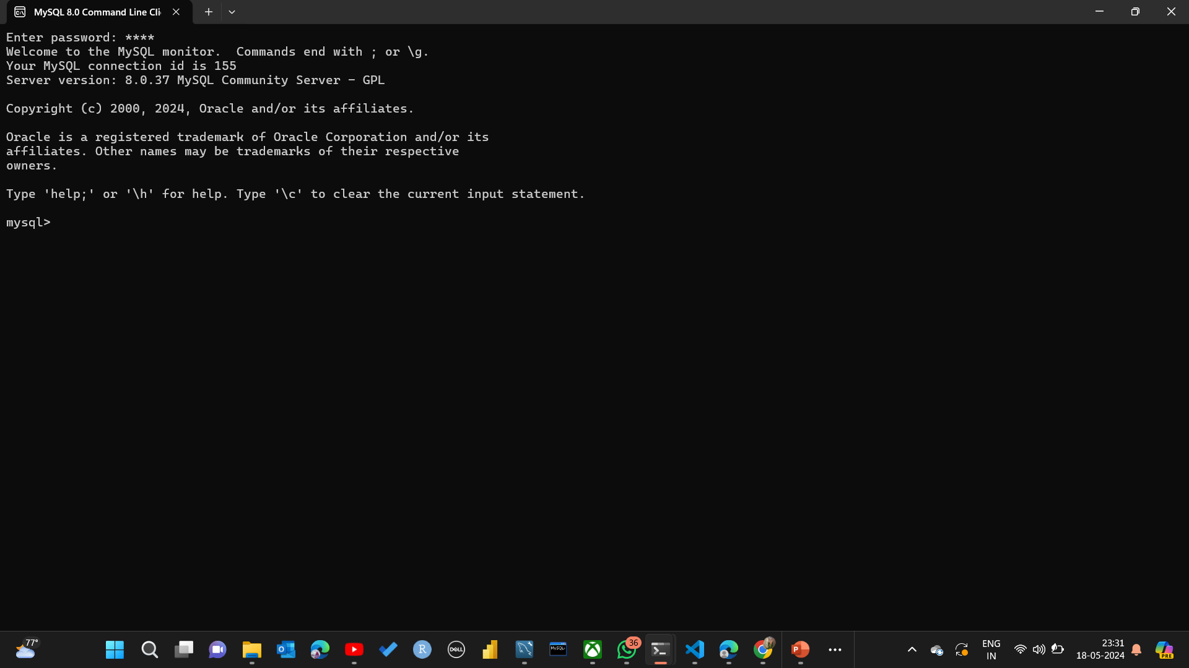
STEP 1: Connect MySQL command line and MySQL workbench
Username:root
Password:root
Port:330

Slide 6
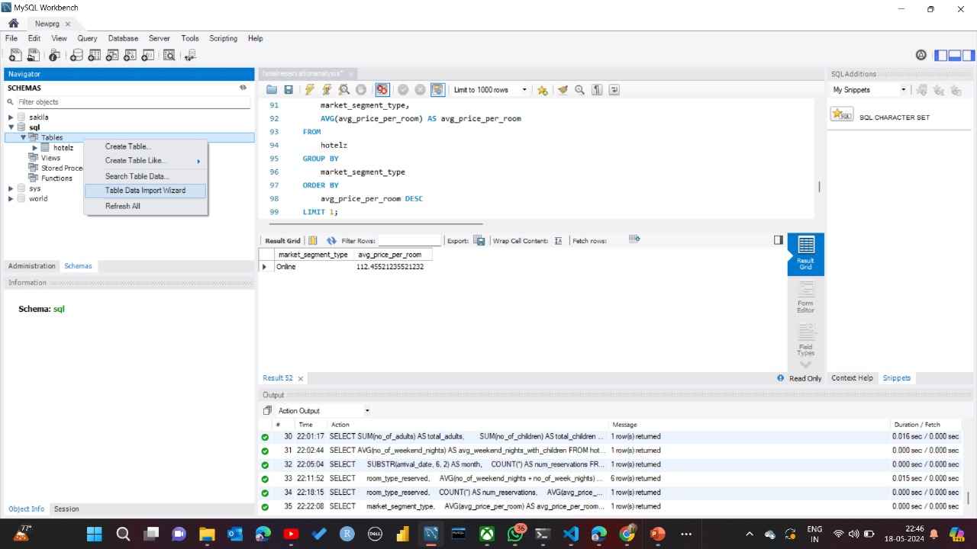
STEP 2: Import Dataset

Slide 7
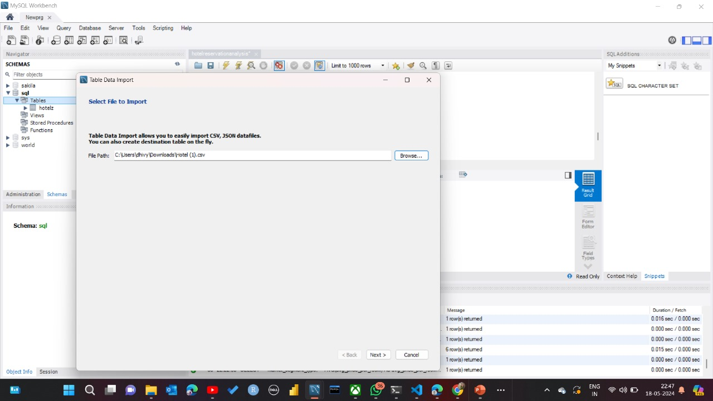

Slide 8
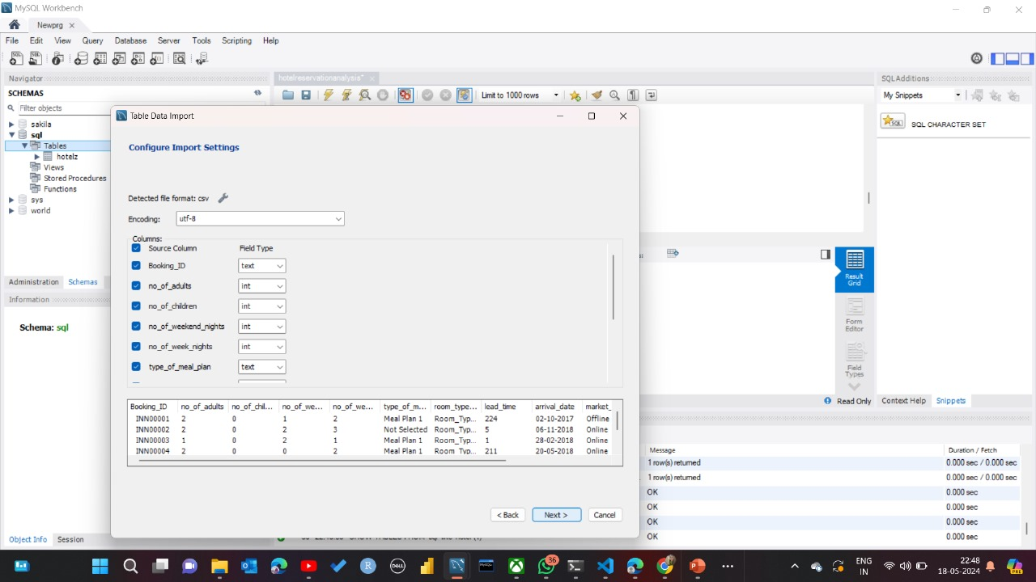

Slide 9
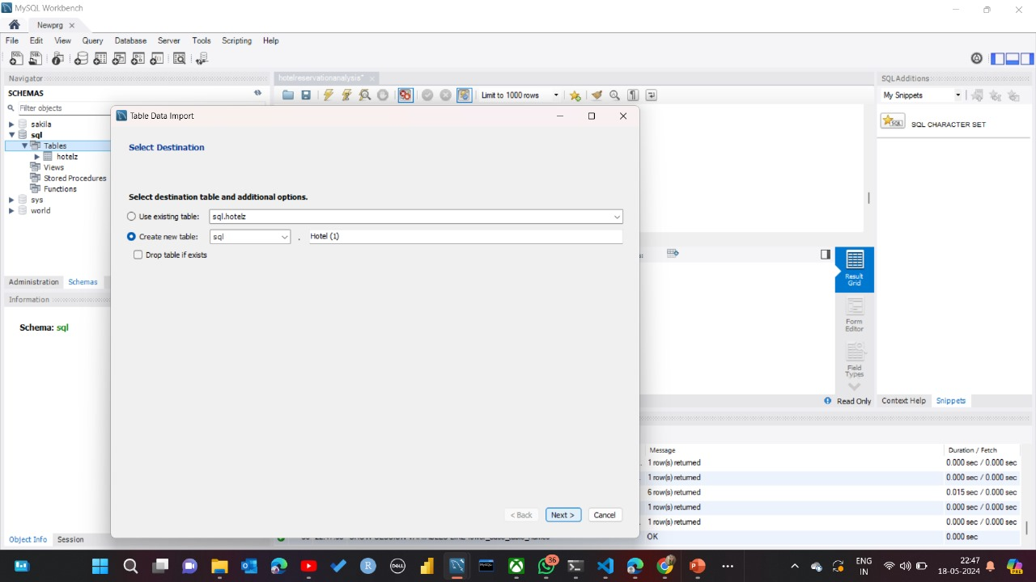

Slide 10
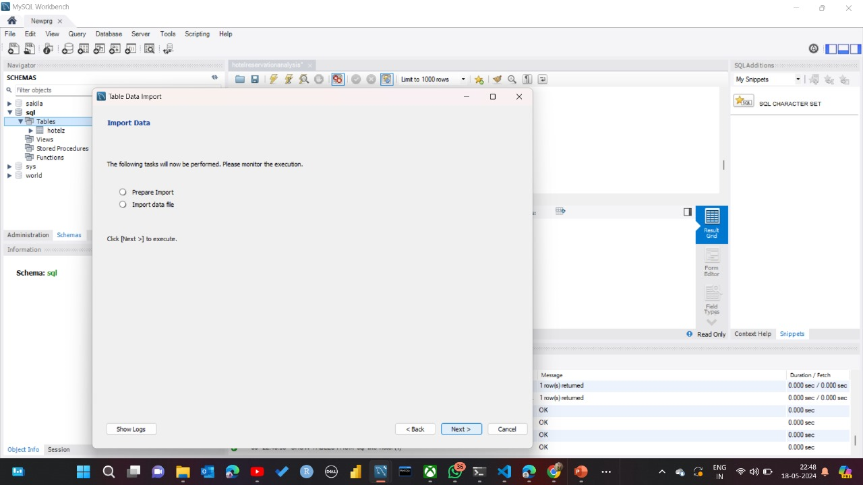

Slide 11
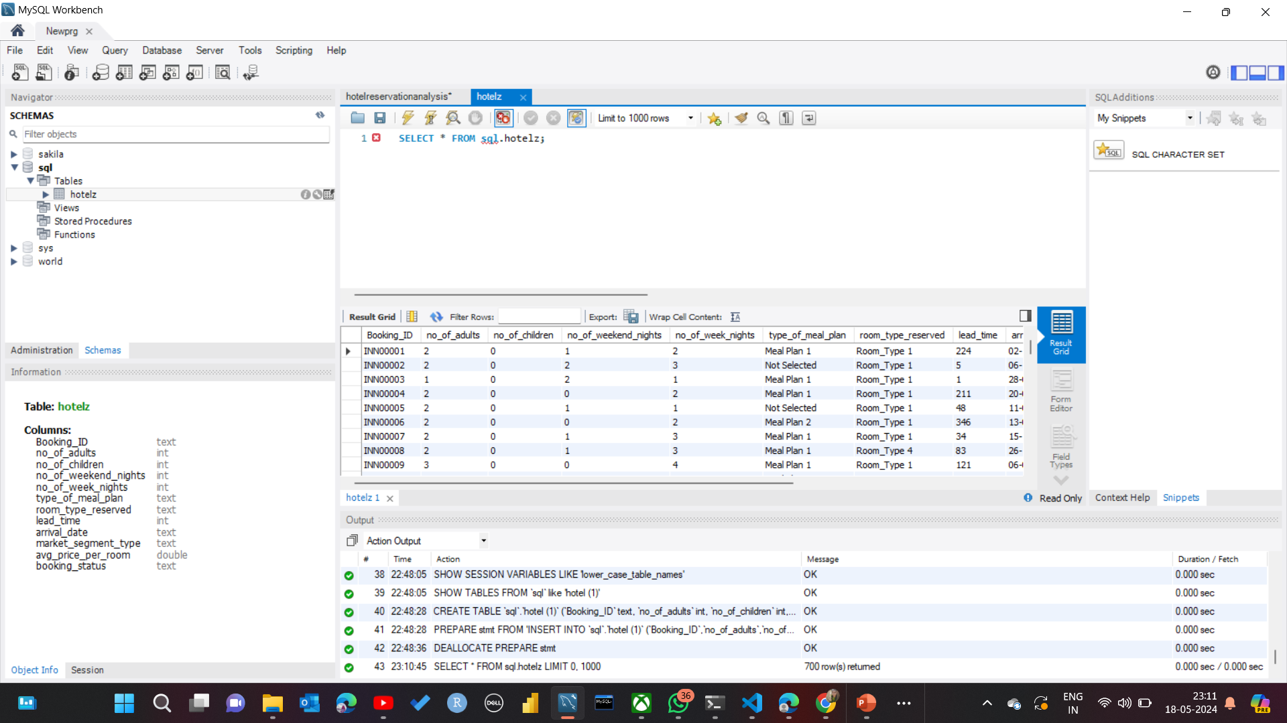

Slide 12
Schema: sql
Table:hotelz Columns:
Booking_ID | text
no_of_adults | int
no_of_children | int
no_of_weekend_nights | int
no_of_week_nights | int
type_of_meal_plan | text
room_type_reserved | text
lead_time | int
arrival_date | text
market_segment_type | text
avg_price_per_room | double
booking_status | text

Slide 13
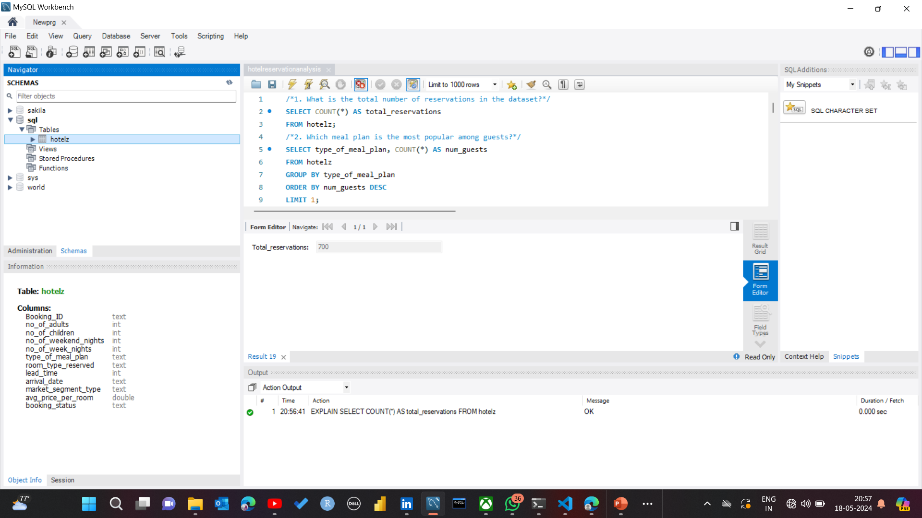
1. What is the total number of reservations in the dataset?
SELECT COUNT(*) AS total_reservations
FROM hotelz;

Slide 14
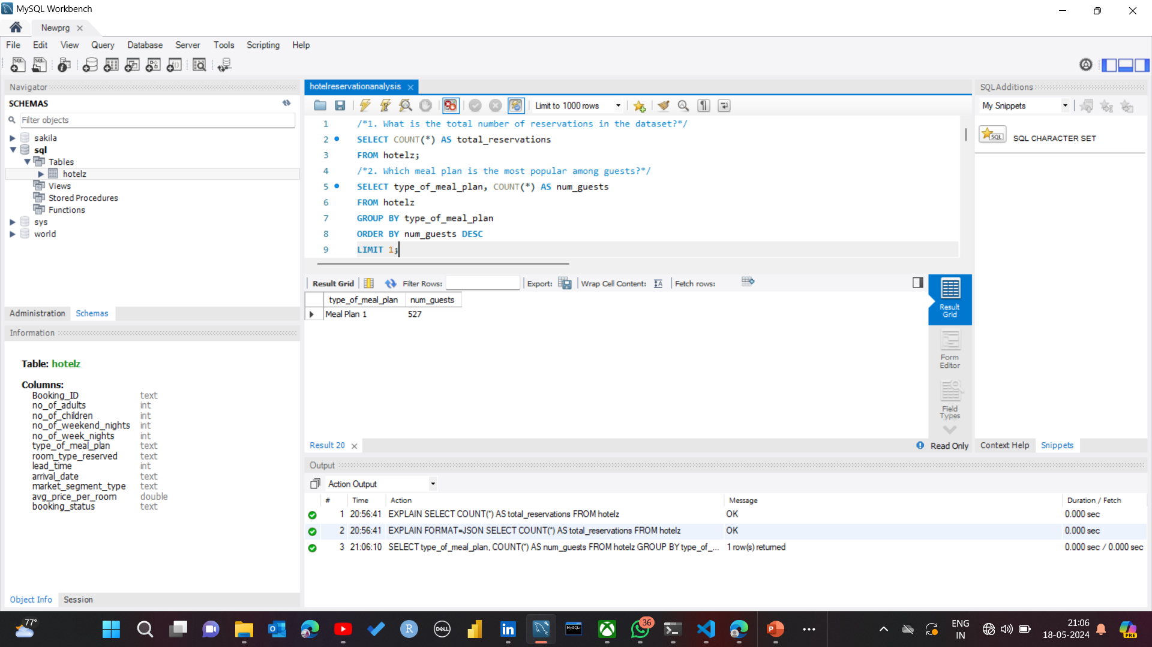
2. Which meal plan is the most popular among guests? SELECT type_of_meal_plan, COUNT(*) AS num_guests FROM hotelz GROUP BY type_of_meal_plan ORDER BY num_guests DESCLIMIT 1;

Slide 15
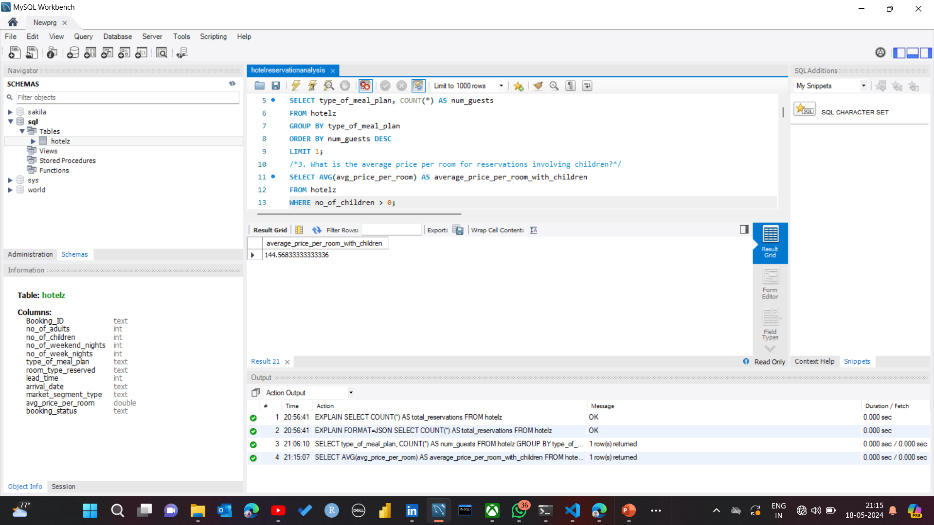
3. What is the average price per room for reservations involving children? SELECT AVG(avg_price_per_room) AS average_price_per_room_with_children FROM hotelzWHERE no_of_children > 0;

Slide 16
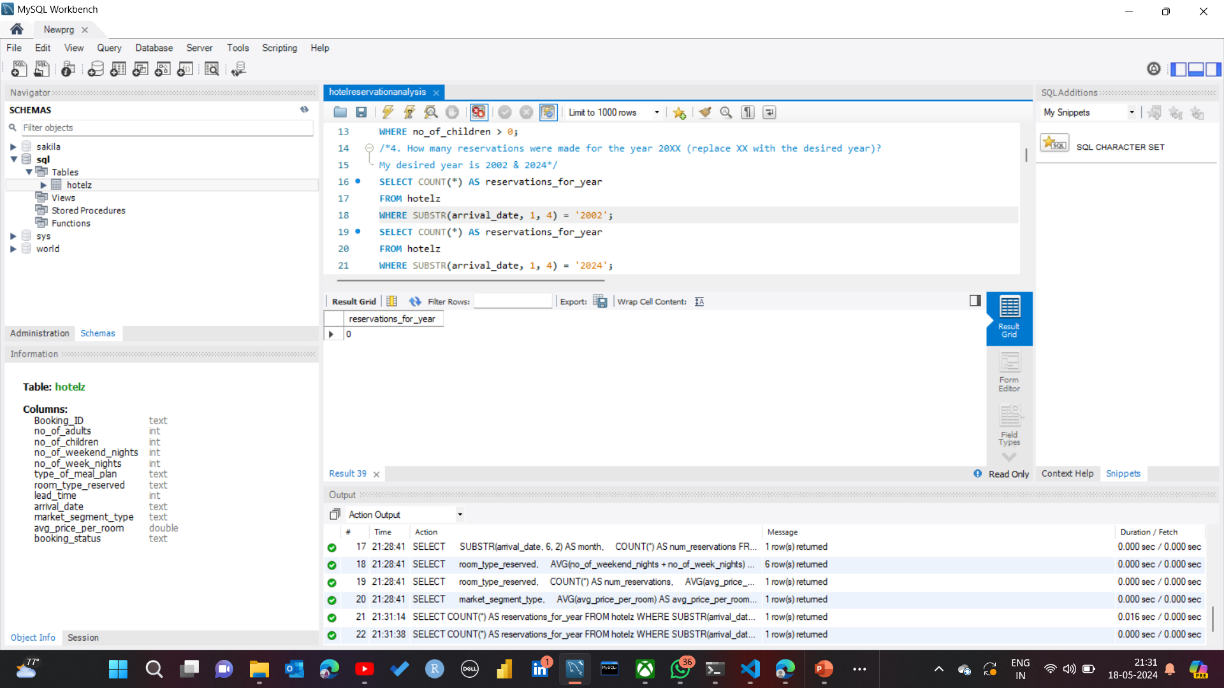
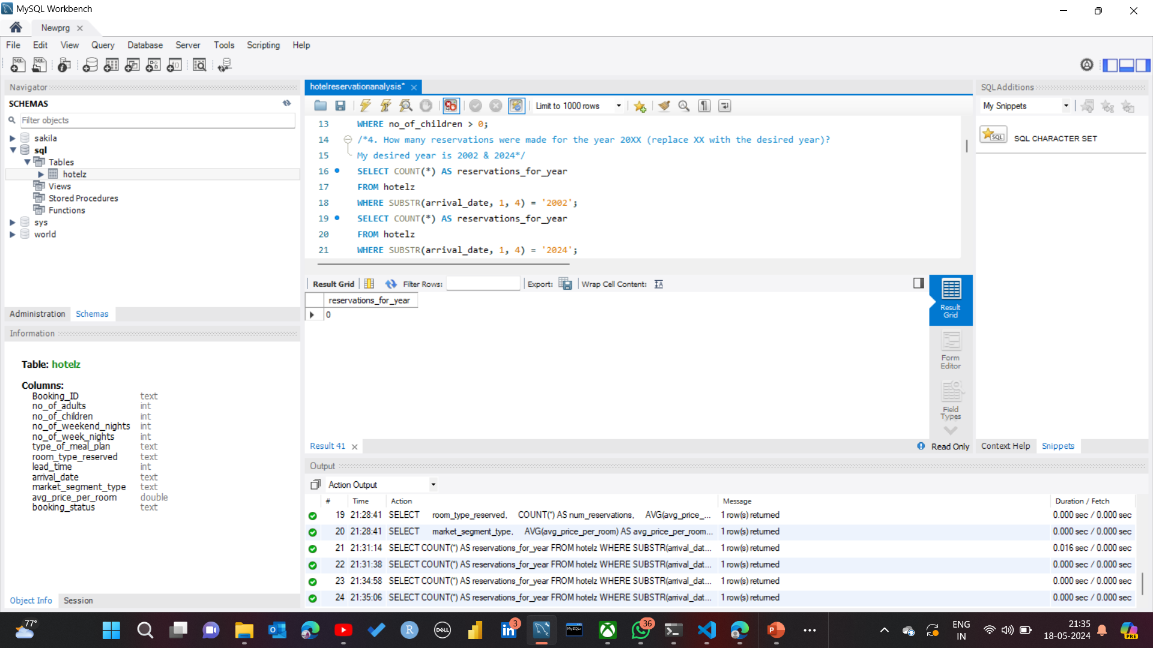
4. How many reservations were made for the year 20XX (replace XX with the desired year)? My desired year is 2002 & 2024 SELECT COUNT(*) AS reservations_for_year FROM hotelz WHERE SUBSTR(arrival_date, 1, 4) = '2002’; - - YEAR 2002 SELECT COUNT(*) AS reservations_for_year FROM hotelz WHERE SUBSTR(arrival_date, 1, 4) = '2024’; - -YEAR 2024

Slide 17
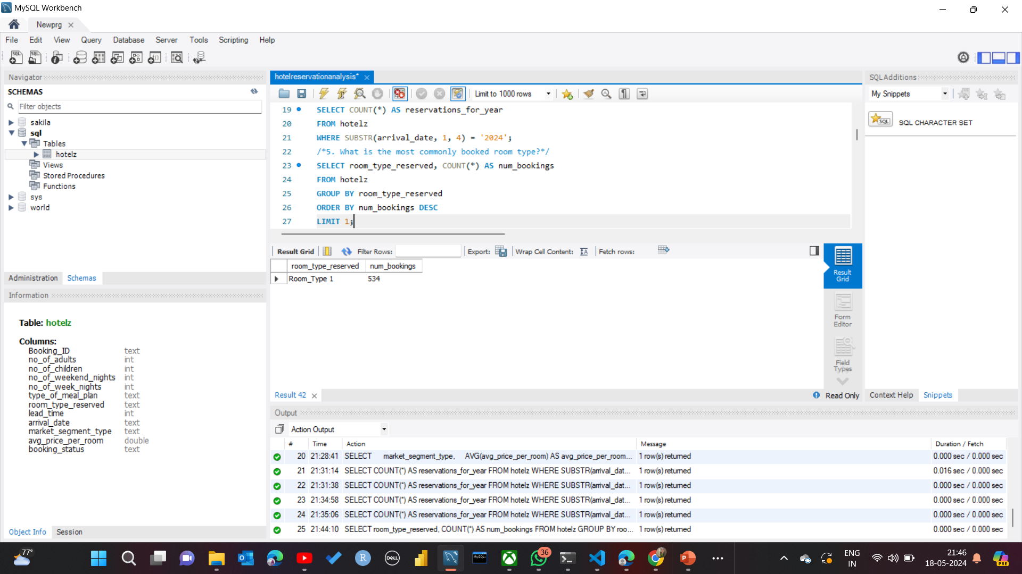
5. What is the most commonly booked room type? SELECT room_type_reserved, COUNT(*) AS num_bookings FROM hotelz GROUP BY room_type_reserved ORDER BY num_bookings DESCLIMIT 1;

Slide 18
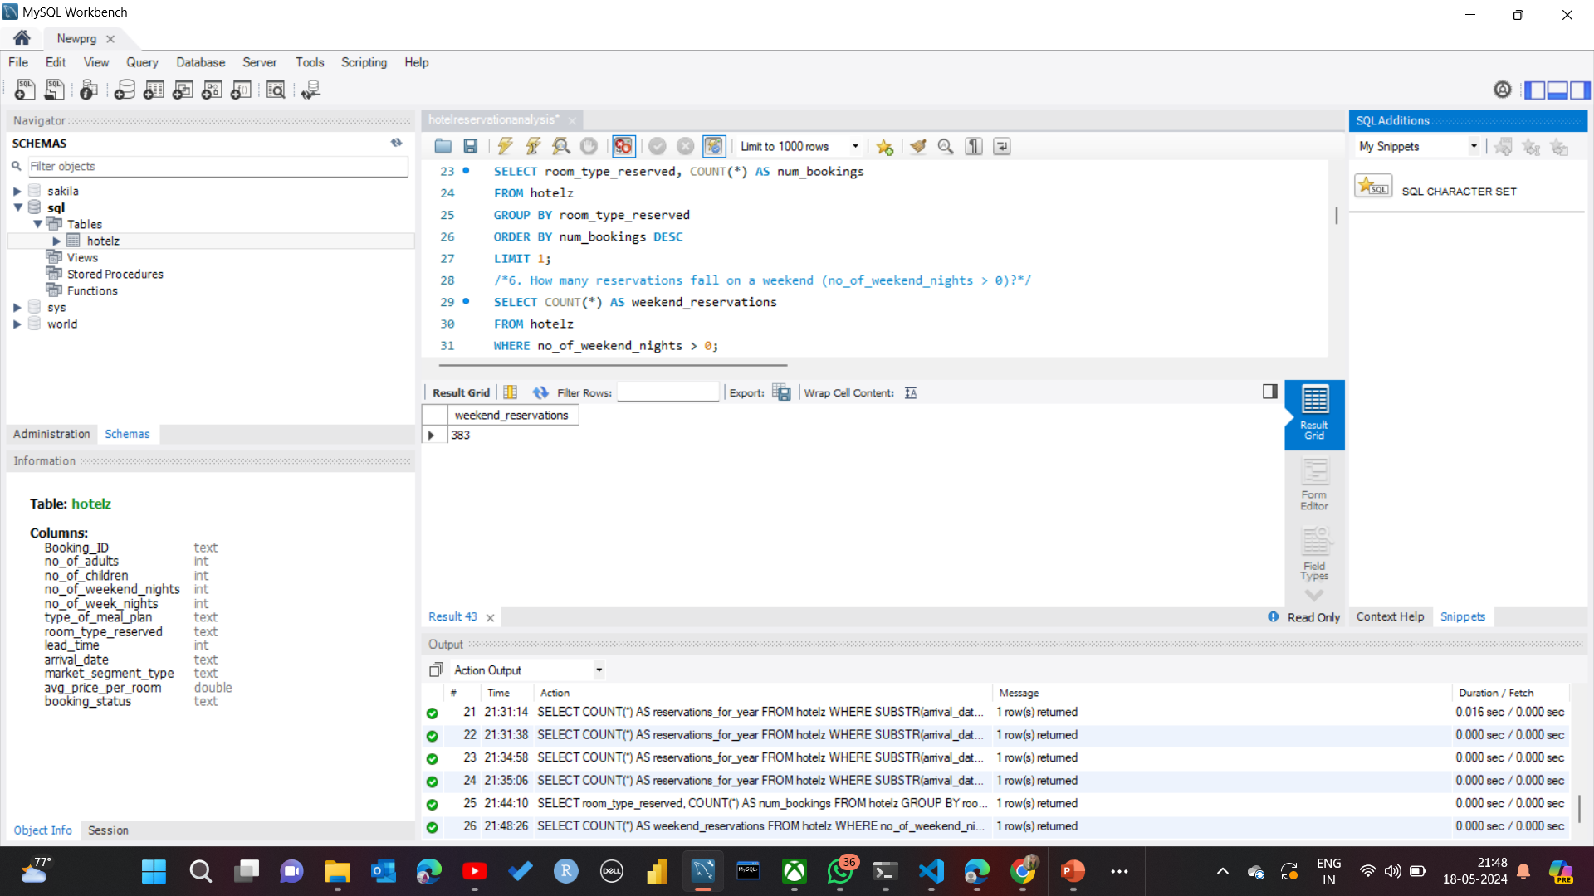
6. How many reservations fall on a weekend (no_of_weekend_nights > 0)? SELECT COUNT(*) AS weekend_reservations FROM hotelz WHERE no_of_weekend_nights > 0;

Slide 19
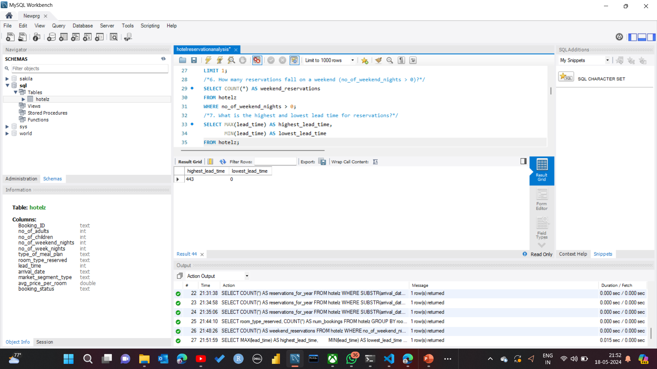
7. What is the highest and lowest lead time for reservations? SELECT MAX(lead_time) AS highest_lead_time, MIN(lead_time) AS lowest_lead_time FROM hotelz;

Slide 20
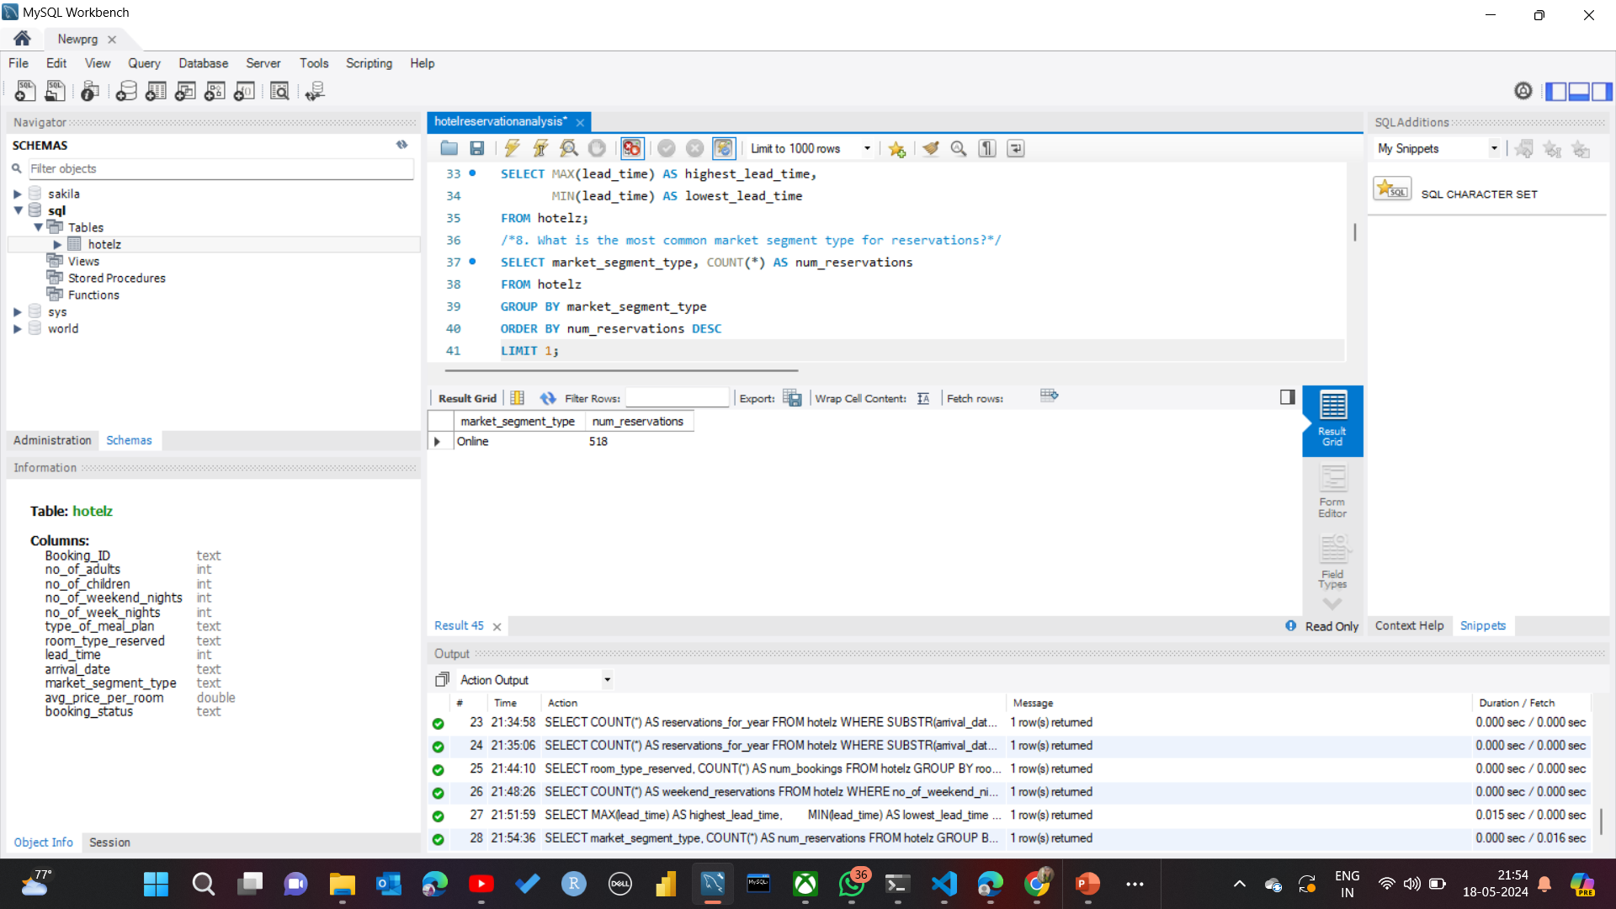
8. What is the most common market segment type for reservations? SELECT market_segment_type, COUNT(*) AS num_reservations FROM hotelz GROUP BY market_segment_type ORDER BY num_reservations DESCLIMIT 1;

Slide 21
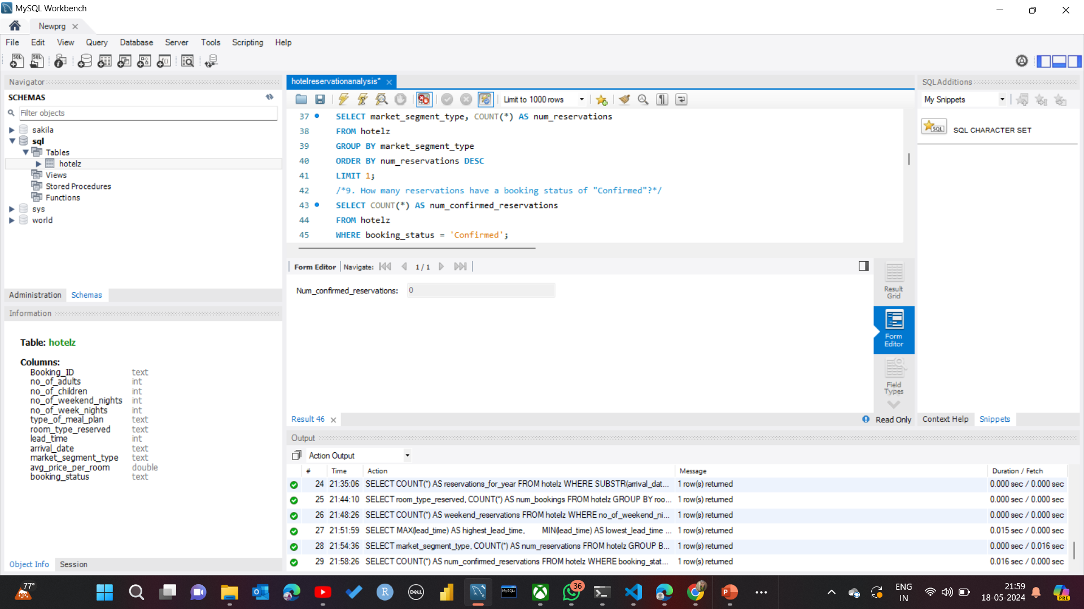
9. How many reservations have a booking status of "Confirmed"? SELECT COUNT(*) AS num_confirmed_reservations FROM hotelz WHERE booking_status = 'Confirmed';

Slide 22
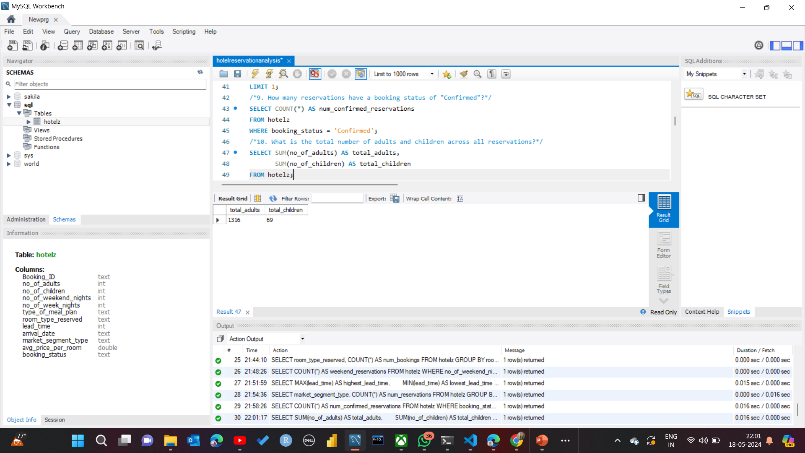
10. What is the total number of adults and children across all reservations? SELECT SUM(no_of_adults) AS total_adults, SUM(no_of_children) AS total_children FROM hotelz;

Slide 23
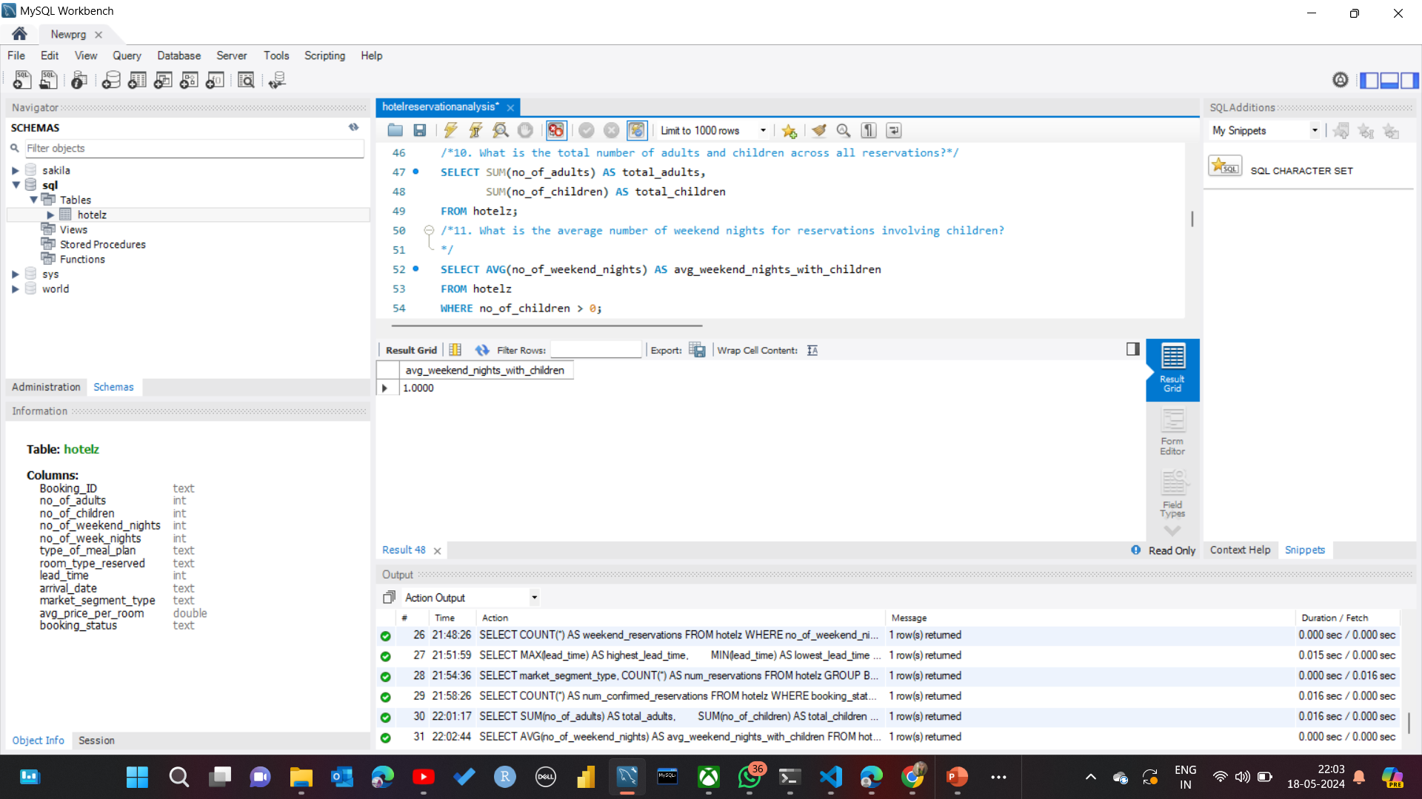
11. What is the average number of weekend nights for reservations involving children? SELECT AVG(no_of_weekend_nights) AS avg_weekend_nights_with_children FROM hotelz WHERE no_of_children > 0;

Slide 24
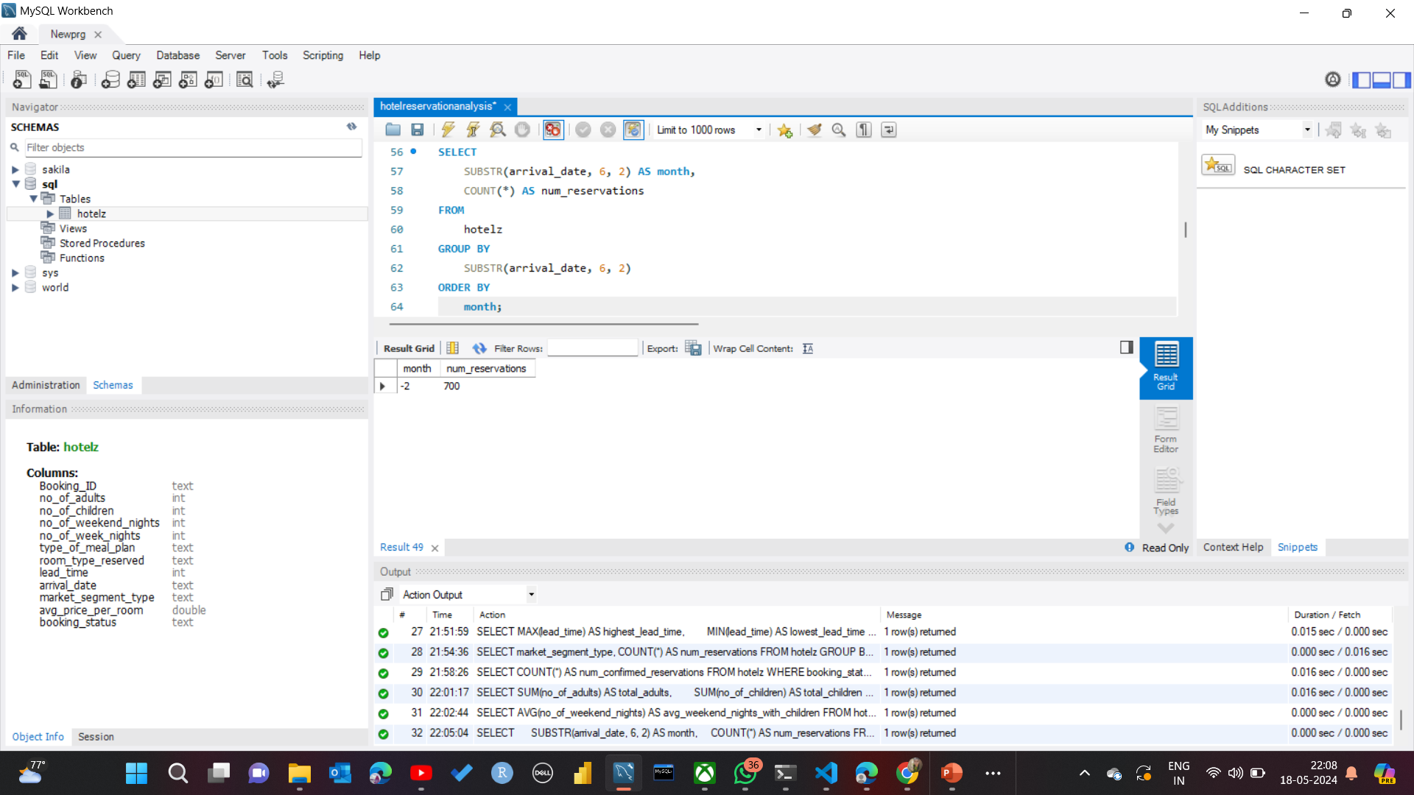
12. How many reservations were made in each month of the year? SELECT SUBSTR(arrival_date, 6, 2) AS month, COUNT(*) AS num_reservations FROM hotelz GROUP BY SUBSTR(arrival_date, 6, 2) ORDER BY month;

Slide 25
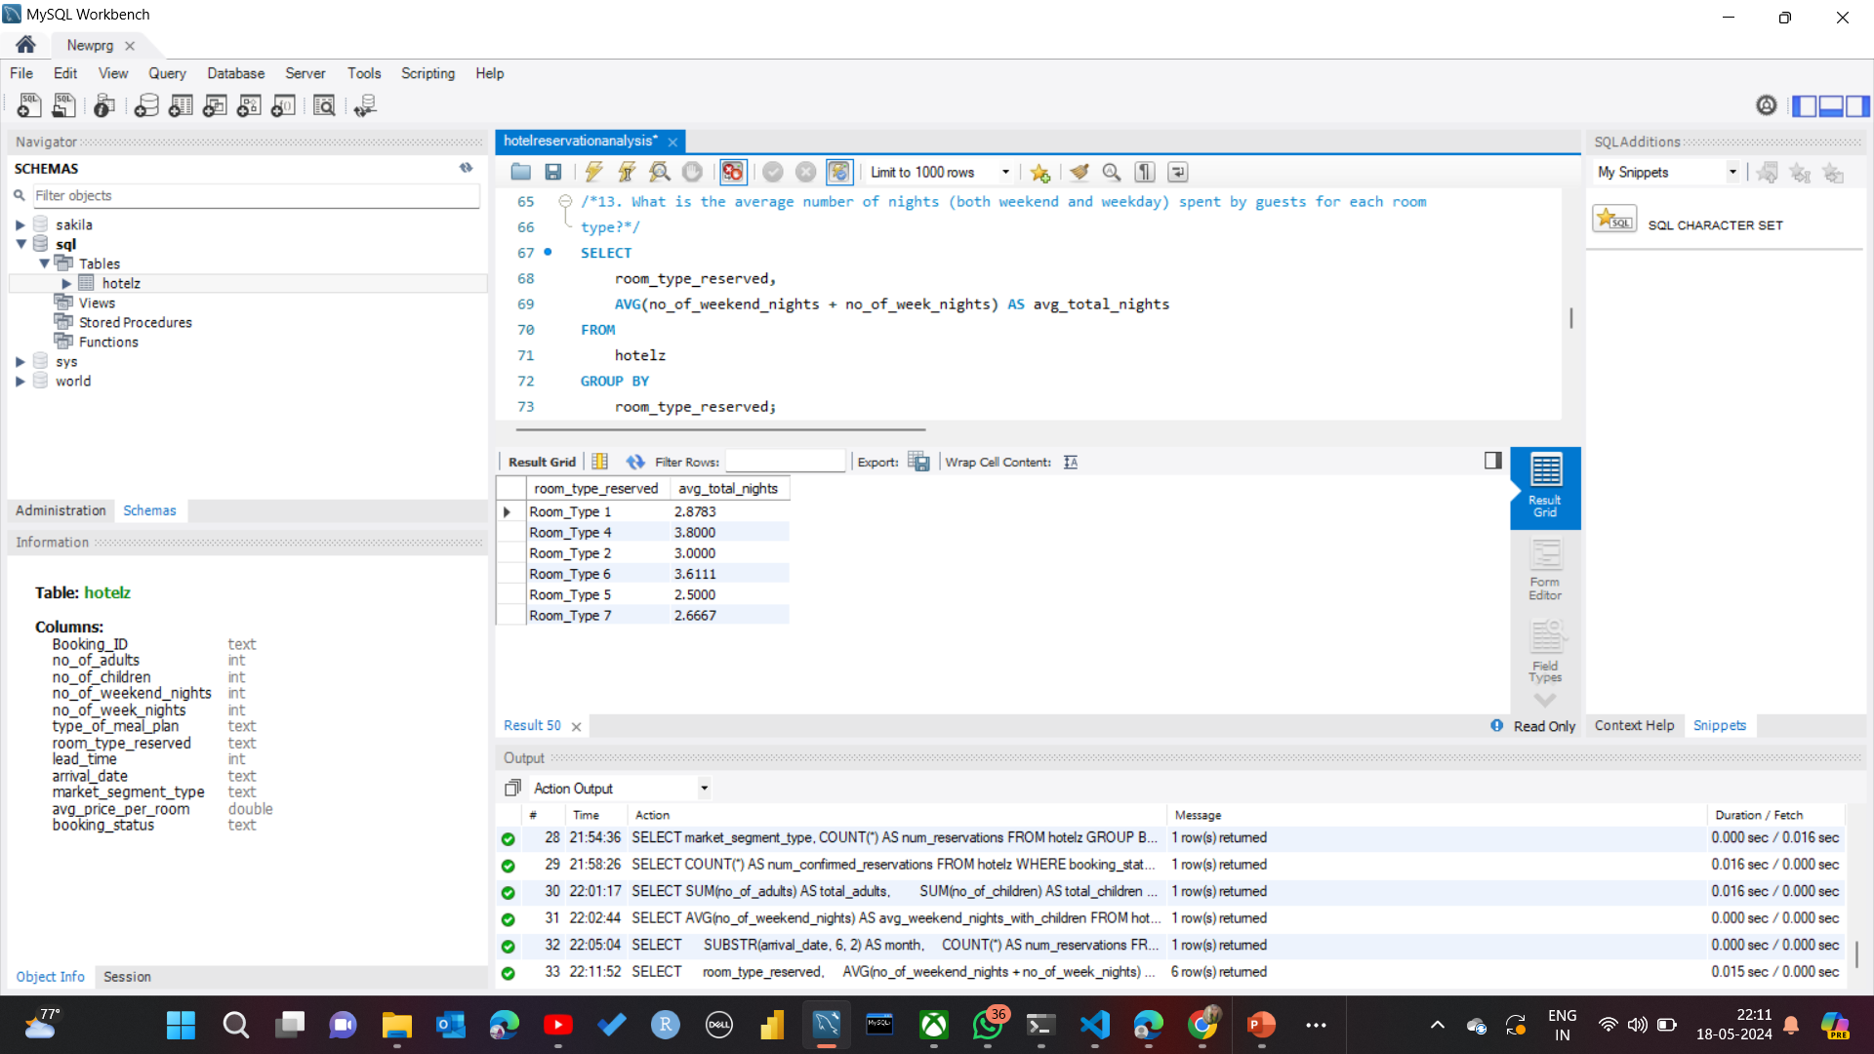
13. What is the average number of nights (both weekend and weekday) spent by guests for each room type? SELECT room_type_reserved, AVG(no_of_weekend_nights + no_of_week_nights) AS avg_total_nights FROM hotelz GROUP BY room_type_reserved;

Slide 26
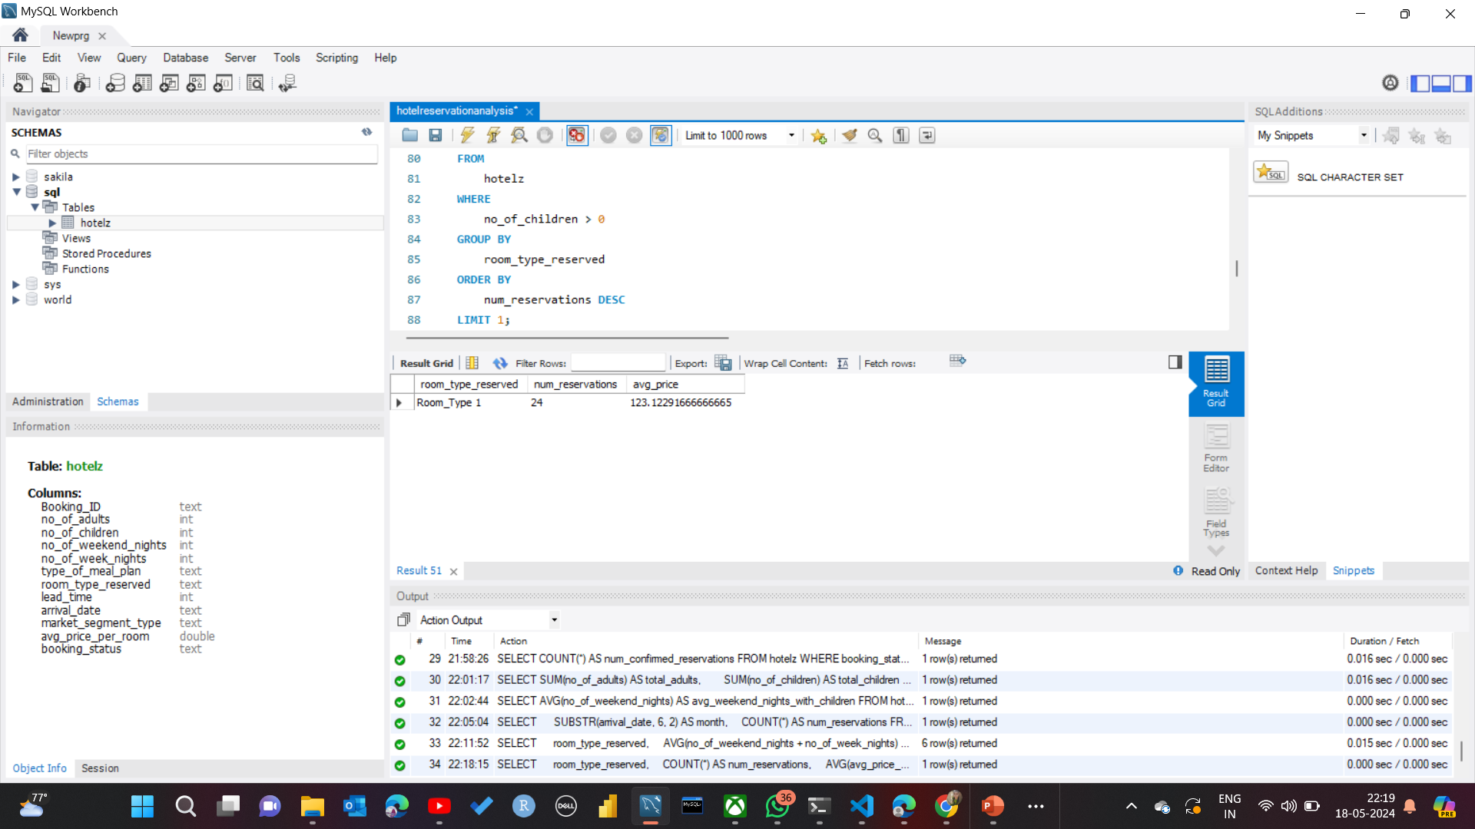
14. For reservations involving children, what is the most common room type, and what is the average price for that room type? SELECT room_type_reserved COUNT(*) AS num_reservations, AVG(avg_price_per_room) AS avg_price FROM hotelz WHERE no_of_children > 0 GROUP BY room_type_reserved ORDER BY num_reservations DESCLIMIT 1;

Slide 27
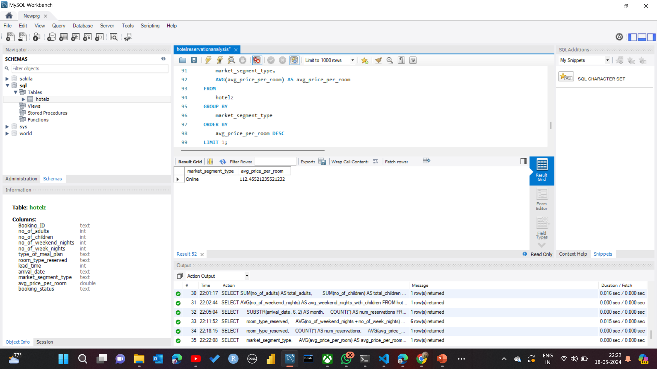
15. Find the market segment type that generates the highest average price per room? SELECT market_segment_type, AVG(avg_price_per_room) AS avg_price_per_room FROM hotelz GROUP BY market_segment_type ORDER BY avg_price_per_room DESCLIMIT 1;

Slide 28


